Slide 1
Attention
2020.09.02
심아름

Slide 2
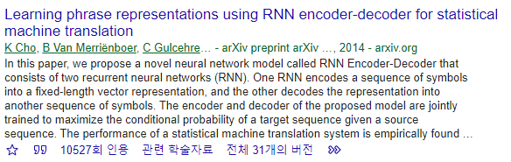
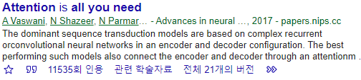
Papers

Slide 3
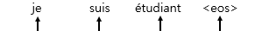
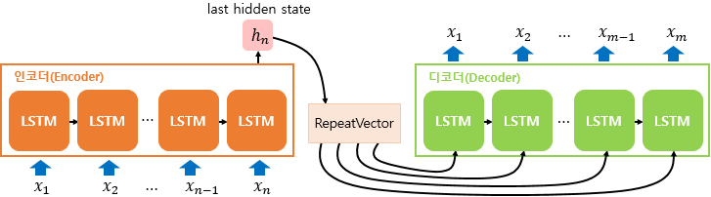
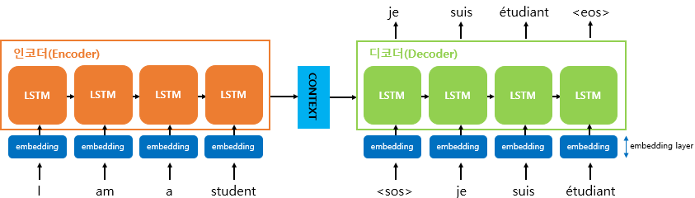
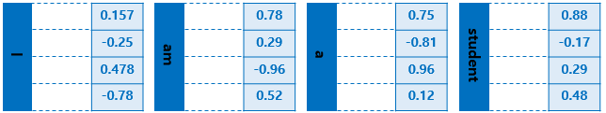
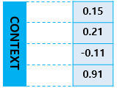
1. Seq2seq

Slide 4
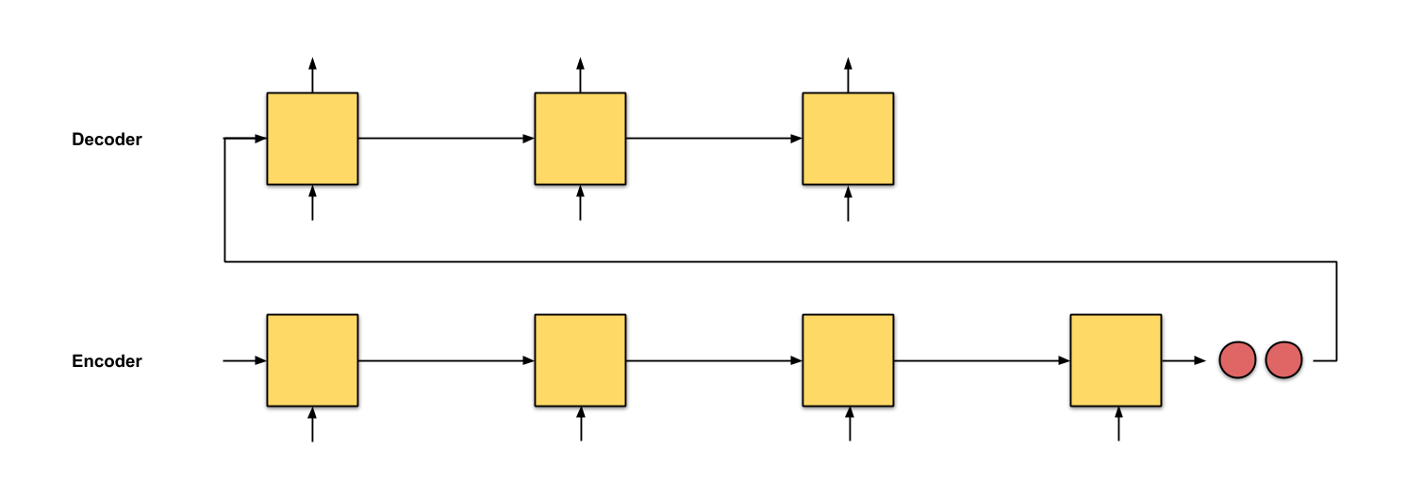
2. Problem with seq2seq
seq2seq with an input sequence of length 4
seq2seq with an input sequence of length 64

Slide 5
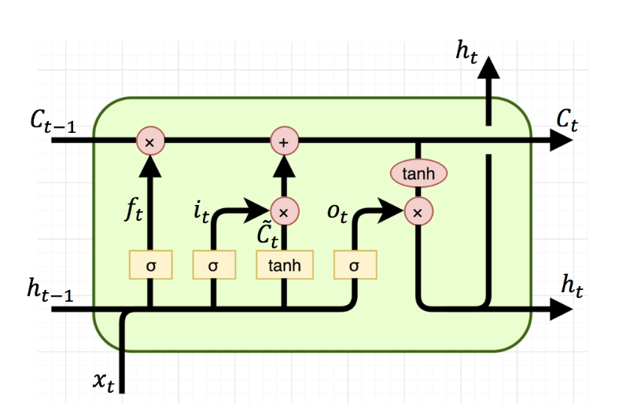
Ref. LSTM의 기본구조

Slide 6
3. What is Attention
hidden state
h₁
h₂
h₂
h_{n}

Slide 7
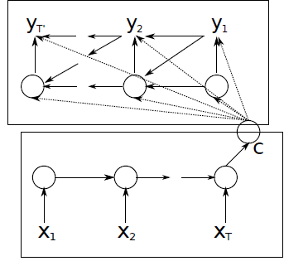
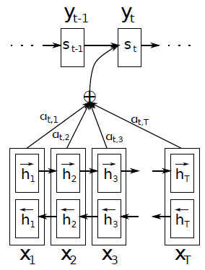
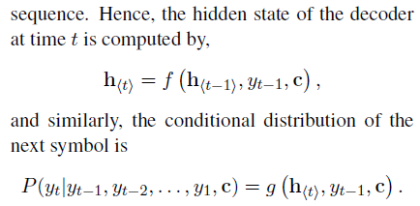
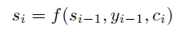
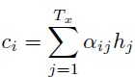
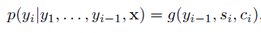
4. Seq2seq vs Seq2seq + Attention
Decoder
Decoder
Alignment
Encoder
Encoder
Decoder
Decoder
,
➔ ( y₁, …, y_{t-1}, c ) 를 이용해서 y_{t} 예측
( y₁, …, y_{t-1}, c_{i} ) 를 이용해서 y_{t} 예측

Slide 8
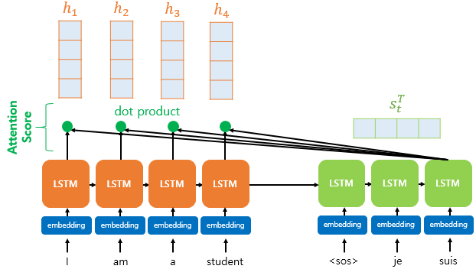
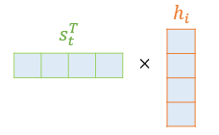
5. Seq2seq + Attention (1) Attention Score
score(s_{t}, h_{i}) = s^{T}_{t}h_{i}
e^{t} = [ s^{T}_{t}h_{1,} … , s^{T}_{t}h_{N} ]

Slide 9
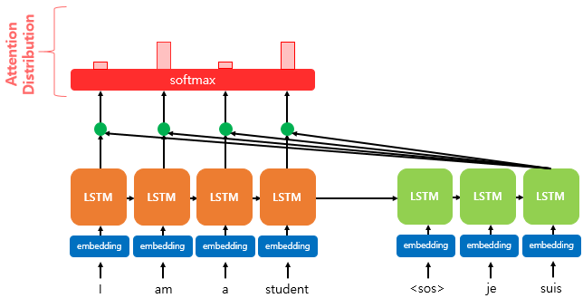
5. Seq2seq + Attention (2) Attention Distribution
α^{t} = softmax( e^{t} )

Slide 10
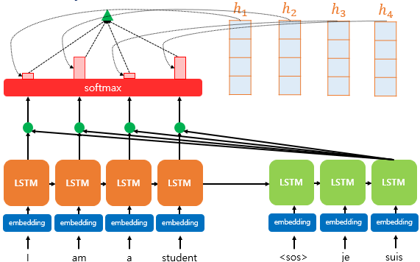
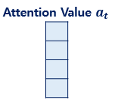
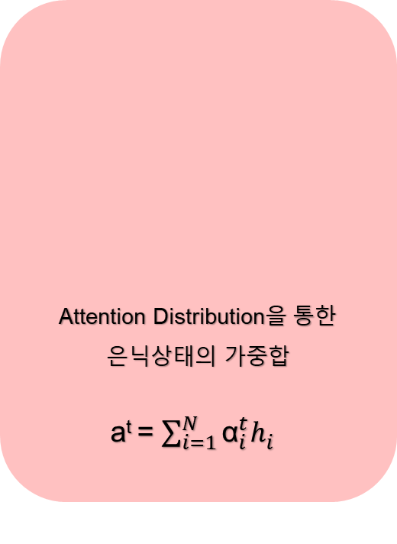
5. Seq2seq + Attention (3) Attention Value
Attention Distribution을 통한 은닉상태의 가중합
a^{t} = $\sum_{i=1}^{N}{{\text{α}}_{i}^{t}h_{i}^{}}$

Slide 11
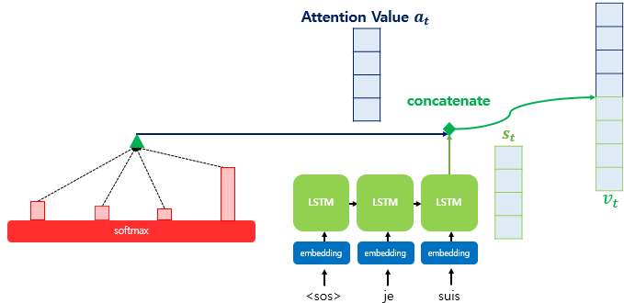
5. Seq2seq + Attention (4) Concatenate

Slide 12
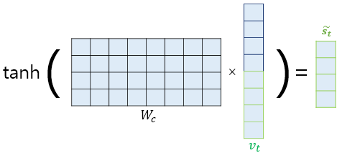
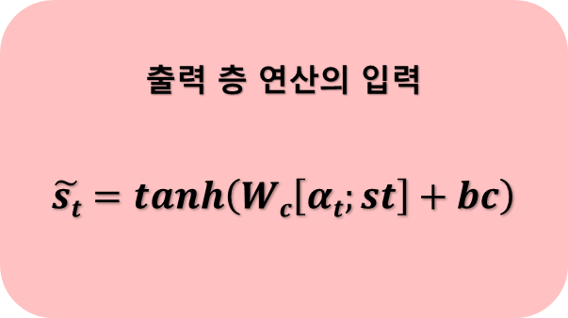
5. Seq2seq + Attention (5) $\tilde{st}$
출력 층 연산의 입력
$$\tilde{st}=tanh\left(Wc\left[αt;st\right]+bc\right)$$

Slide 13
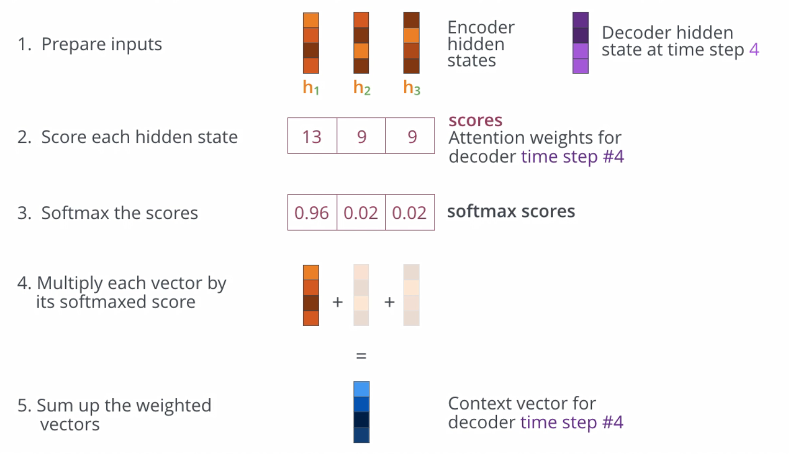
5. Seq2seq + Attention

Slide 14
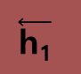
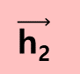
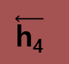
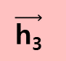
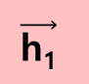
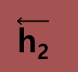
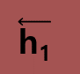
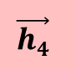
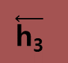
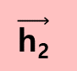

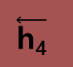
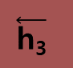

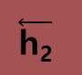
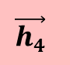
6. Bi-direction model
hidden state
hidden state
$$\overset{⃖}{\text{h}\text{1}}$$
$$\overset{⃖}{\text{h}\text{2}}$$
$$\overset{⃖}{\text{h}\text{3}}$$
$$\overset{⃖}{\text{h}\text{4}}$$
$$\overset{⃖}{\text{h}\text{1}}$$
$$\overset{⃖}{\text{h}\text{2}}$$
$$\overset{⃖}{\text{h}\text{3}}$$
$$\overset{⃖}{\text{h}\text{4}}$$
$$\vec{\text{h}\text{1}}$$
$$\vec{\text{h}\text{2}}$$
$$\vec{\text{h}\text{3}}$$
$$\vec{h4}$$
$$\vec{\text{h}\text{1}}$$
$$\vec{\text{h}\text{2}}$$
$$\vec{\text{h}\text{3}}$$
$$\vec{h4}$$

Slide 15
7. About Wrong Case
Tu
→ wrong prediction
Tu
wrong prediction affect
next word prediction
Teacher Forcing :
target word (ground truth) passed
as the next input
to decoder faster and stable model train!

Slide 16
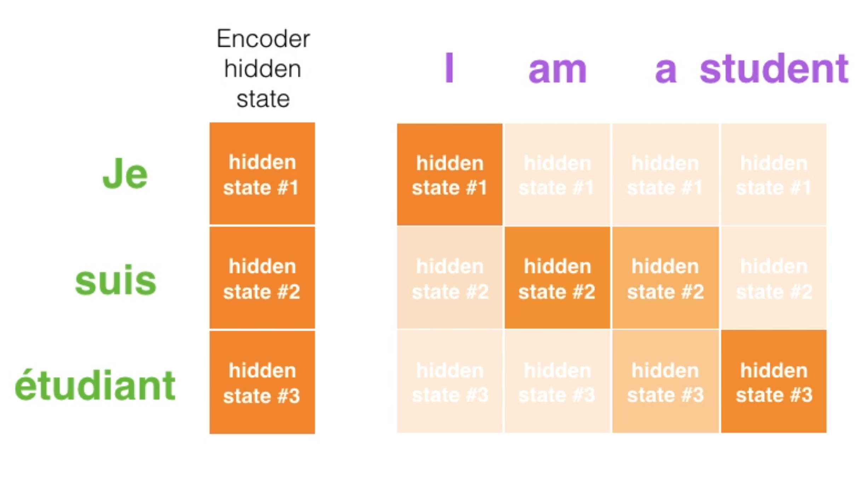
8. Advantage of Attention

Slide 17
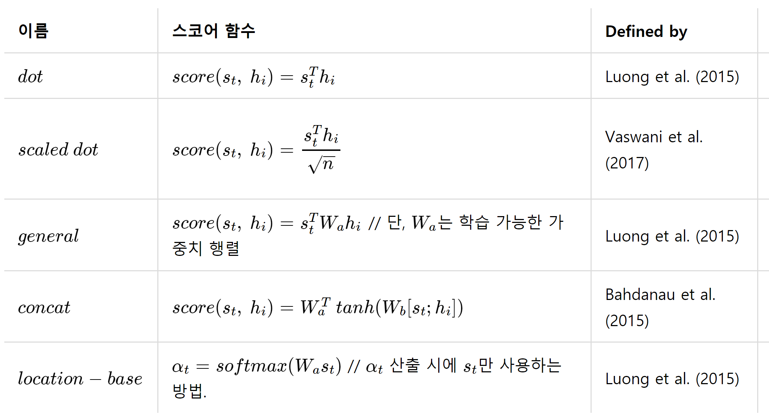
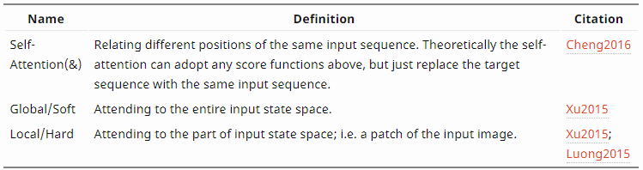
9. Several Popular Attention

Slide 18

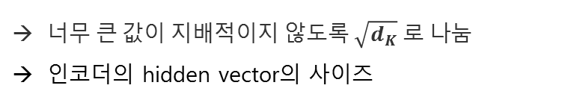

10. Scaled Dot-Product Attention
score(s_{t}, h_{i}) = s^{T}_{t}h_{i}
e^{t} = [ s^{T}_{t}h_{1,} … , s^{T}_{t}h_{N} ]
$\text{Attention} \text{Score}\text{ =} \frac{ \text{e}\text{t}\text{ = [ }\text{sTth}\text{1}\text{, … , }\text{sTthN}\text{ ] } }{\sqrt{d_{K}}}$
너무 큰 값이 지배적이지 않도록 $\sqrt{d_{K}} 로 나$눔
인코더의 hidden vector의 사이즈

Slide 19
11. Self Attention
She is eating a green apple.
The animal didn’t cross the street because it was too _____.
The animal didn’t cross the street because it was too _____.
tired
wide

Slide 20
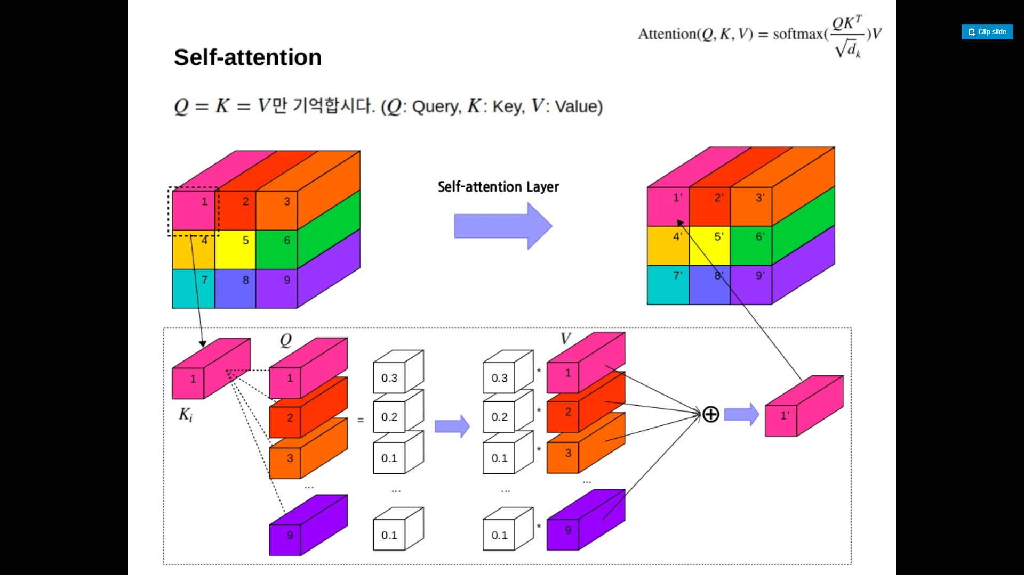
11. Self Attention
1 | 2 | 3 | 4 | 5 | 6 | 7 | 8 | 9
1’ | 2’ | 3’ | 4’ | 5’ | 6’ | 7’ | 8’ | 9’

Slide 21
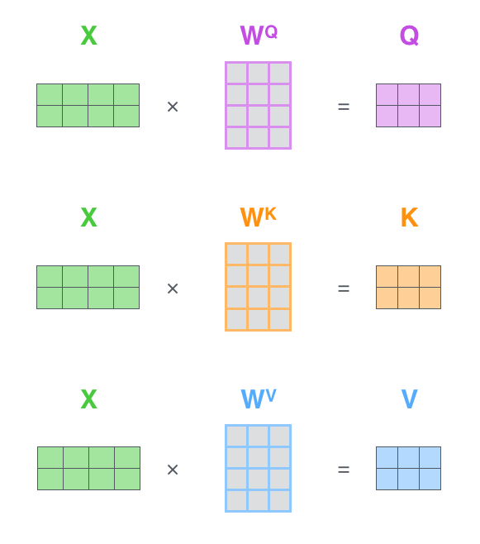
11. Self Attention

Slide 22
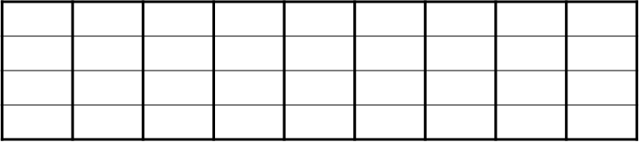
11. Self Attention
1 | 2 | 3 | 4 | 5 | 6 | 7 | 8 | 9
1’ | 2’ | 3’ | 4’ | 5’ | 6’ | 7’ | 8’ | 9’
softmax( x )

Slide 23
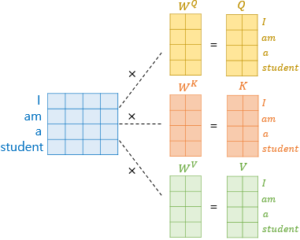
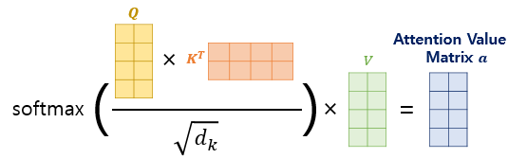
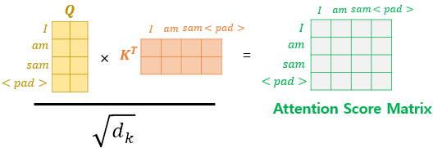
12. Masked Self-Attention

Slide 24
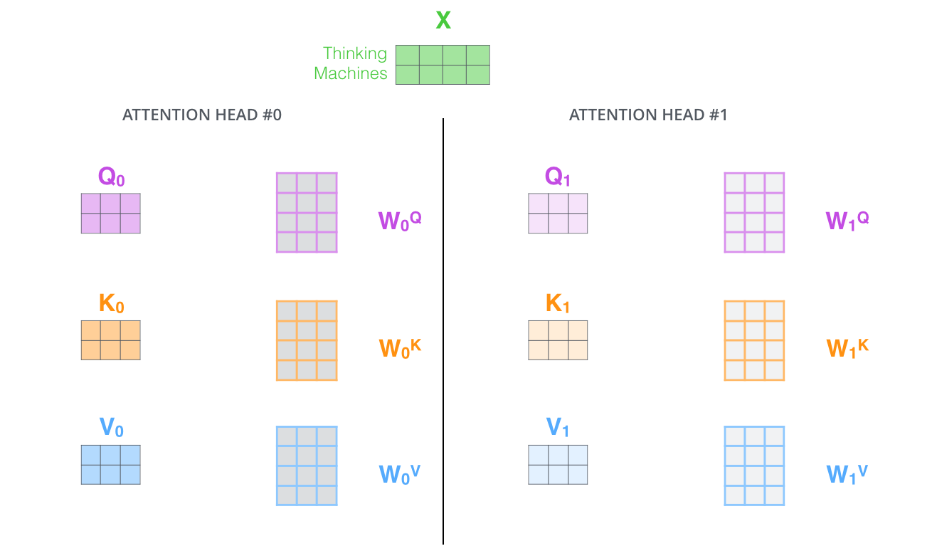
13. Multi-Head Attention

Slide 25

13. Multi-Head Attention
$\text{M}\text{ultiHead}\text{( }\text{Q}\text{, }\text{K}\text{, }\text{V}\text{ ) }\text{= }\text{Concat}\text{( }{head}_{1}\text{ , }…\text{,}{ head}_{h}\text{) }∙W^{0}$
$where{ head}_{i}=Attention(QW_{i}^{Q},KW_{i}^{K},VW_{i}^{V}$)

Slide 26
Thank you

Slide 27
11. Self Attention
Notes:
Matrix 형태로, 병렬 계산이 가능하기 때문에 속도가 빠르다

Slide 28

4. Transformer

Slide 29

4-5. Wrap-up

Slide 30

4-5. Wrap-up
Encoder

Slide 31

4-5. Wrap-up
Encoder - Decoder

Slide 32

4-5. Wrap-up
Decoder

Slide 33

4-2. Feed-Forward
Position-wise Feed-Forward Networks
FFN(x) = max(0, z〮W₁+b₁)W₂+b₂
Linear transformation_2
f₃ = f₂〮W₂ + b₂
ReLu
f₂ = max(0,f₁)
Linear transformation_1
f₁ = z₁〮W₁ + b₁

Slide 34


4-3. Positional Encoding
love
love
I love you but not love him

